Slide 1
Reliance stock prediction
Ayush Srivastava (MDS202113)
Shramana Guin (MDS202143)

Slide 2
Goal and Motivation
This project proposes to forecast the Reliance stock market closing price.
It is an attempt to determine whether the historical closing prices of the Reliance stock can efficiently help in calculating the closing price o the stock market for future dates.

Slide 3
Introduction
Reliance Industries Limited is an Indian multinational conglomerate company that operates in various sectors such as energy, petrochemicals, textiles, natural resources, retail, and telecommunications. The company's stock is highly valued in the Indian stock market, and investors are always looking for ways to predict its future price movements.
Time series analysis is a statistical technique that is used to analyze time series data. It is based on the assumption that past price movements can be used to predict future movements. Time series analysis involves the use of various statistical techniques such as moving averages, exponential smoothing, and autoregressive integrated moving average (ARIMA) models.

Slide 4
Data collection
We have used the Reliance Stock market data from the following website :
https://finance.yahoo.com
The range of dates used for this project:
Jan 2013- Dec 2022

Slide 5
Objectives of the project
Data Preparation
Data Visualization
Exploratory data analysis
Feature Engineering
Anomaly Detection
Fitting a Linear Regression
Building a time series model – ARIMA
Using an LSTM model to forecast the stock prices
Comparison of the results obtained using both models

Slide 6
Insight into the data
Date - Date of trade
Open - The open is the starting period of trading on a securities exchange or organized over-the-counter market.
Low - Lowest price at which a stock traded during the course of the trading day.
Close - The close is a reference to the end of a trading session in the financial markets when the markets close for the day.
High - Highest price at which a stock traded during the course of the trading day.
Volume - It is the amount of a security that was traded during a given period of time.

Slide 7
Visualization
Plotting Closing Price of Reliance Stock against time.
Notes:
As we know, all these parameters follow the same pattern without much deviation
Theres a dip in between 2020-2021. It signifies a sudden dip in the market for Reliance.

Slide 8
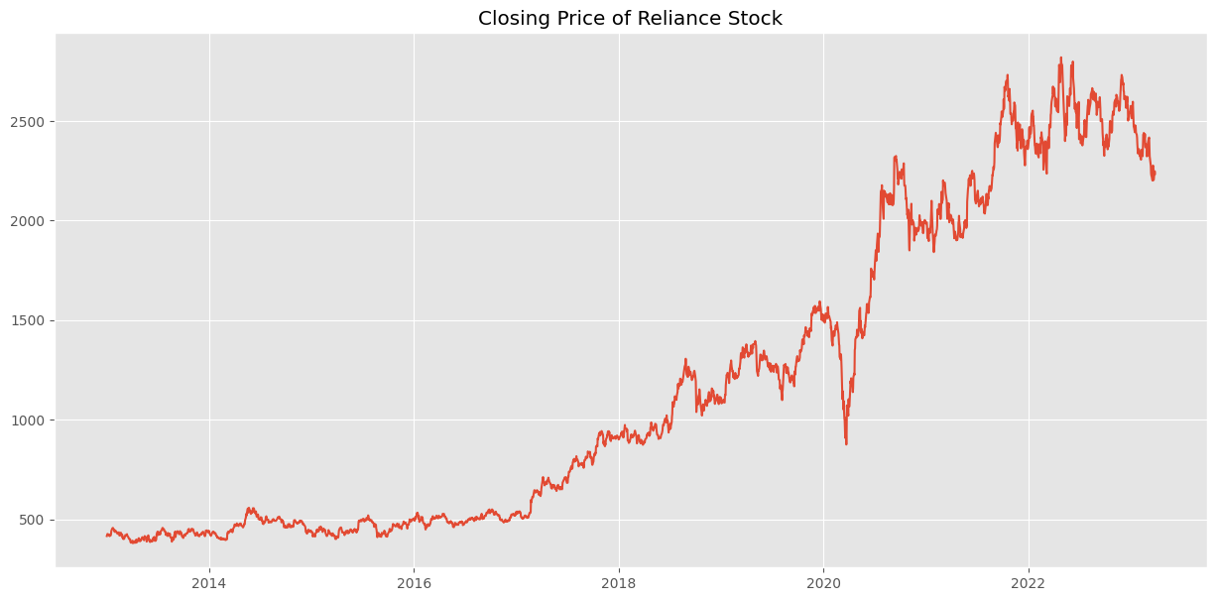

Slide 9
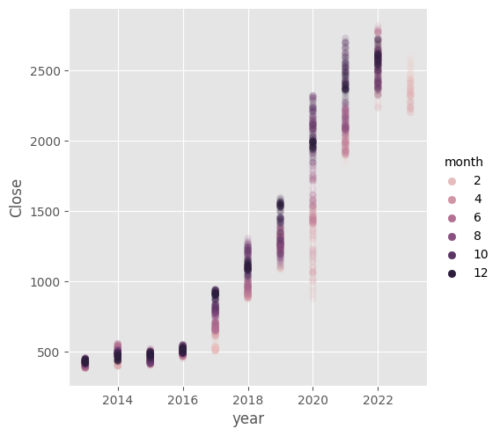
Feature Engineering
Notes:
As we know, all these parameters follow the same pattern without much deviation
Theres a dip in between 2020-2021. It signifies a sudden dip in the market for Reliance.

Slide 10
Anomaly Detection
Write about process
Notes:
As we know, all these parameters follow the same pattern without much deviation
Theres a dip in between 2020-2021. It signifies a sudden dip in the market for Reliance.

Slide 11
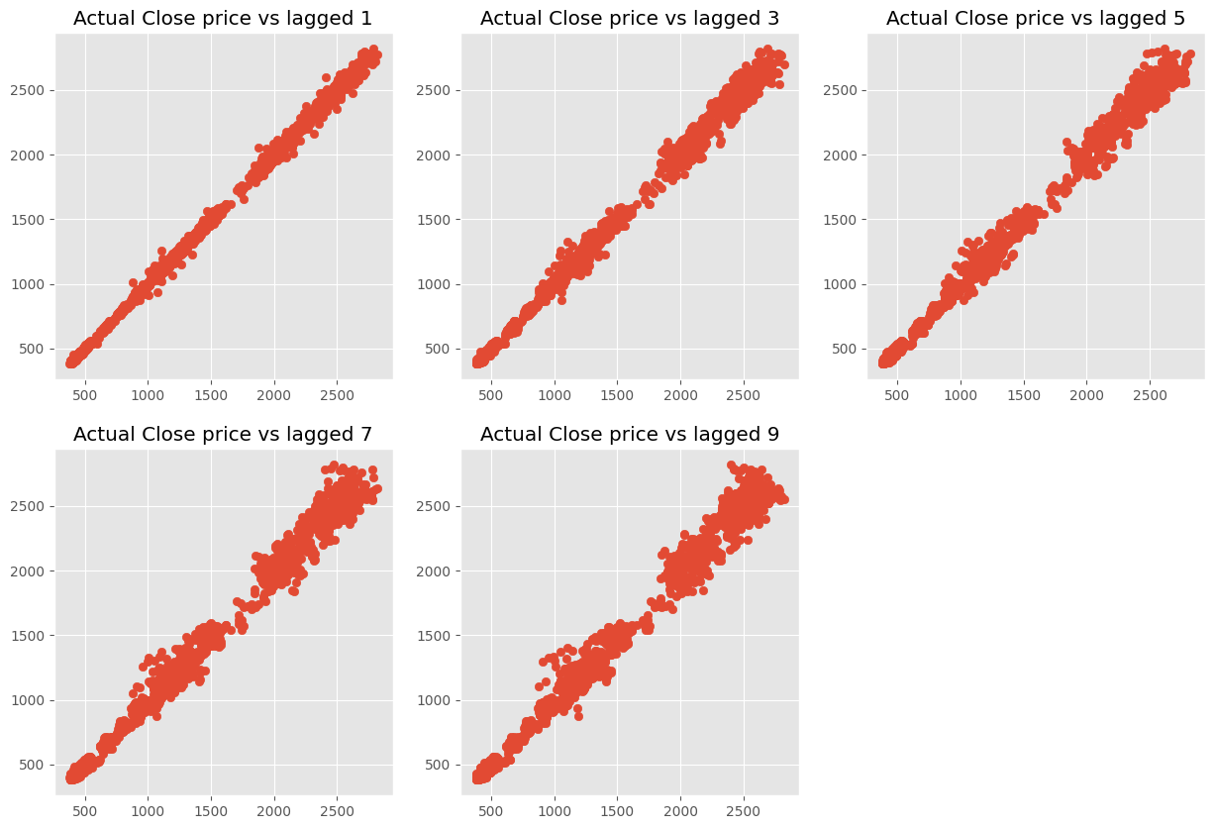
Close vs Shifted

Slide 12
Close vs Shifted

Slide 13
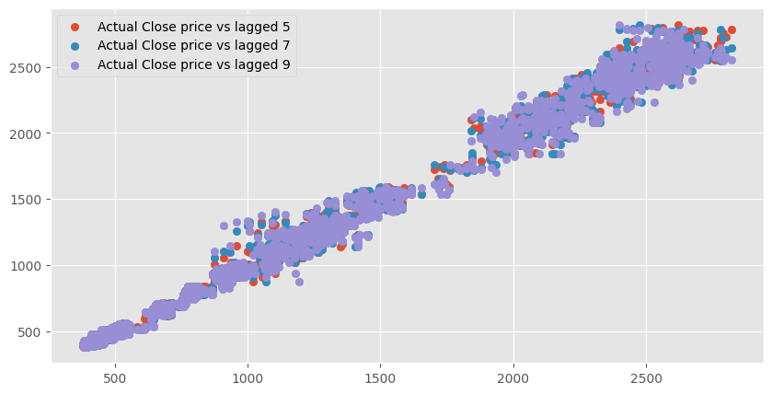
Close vs Shifted (contd.)

Slide 14
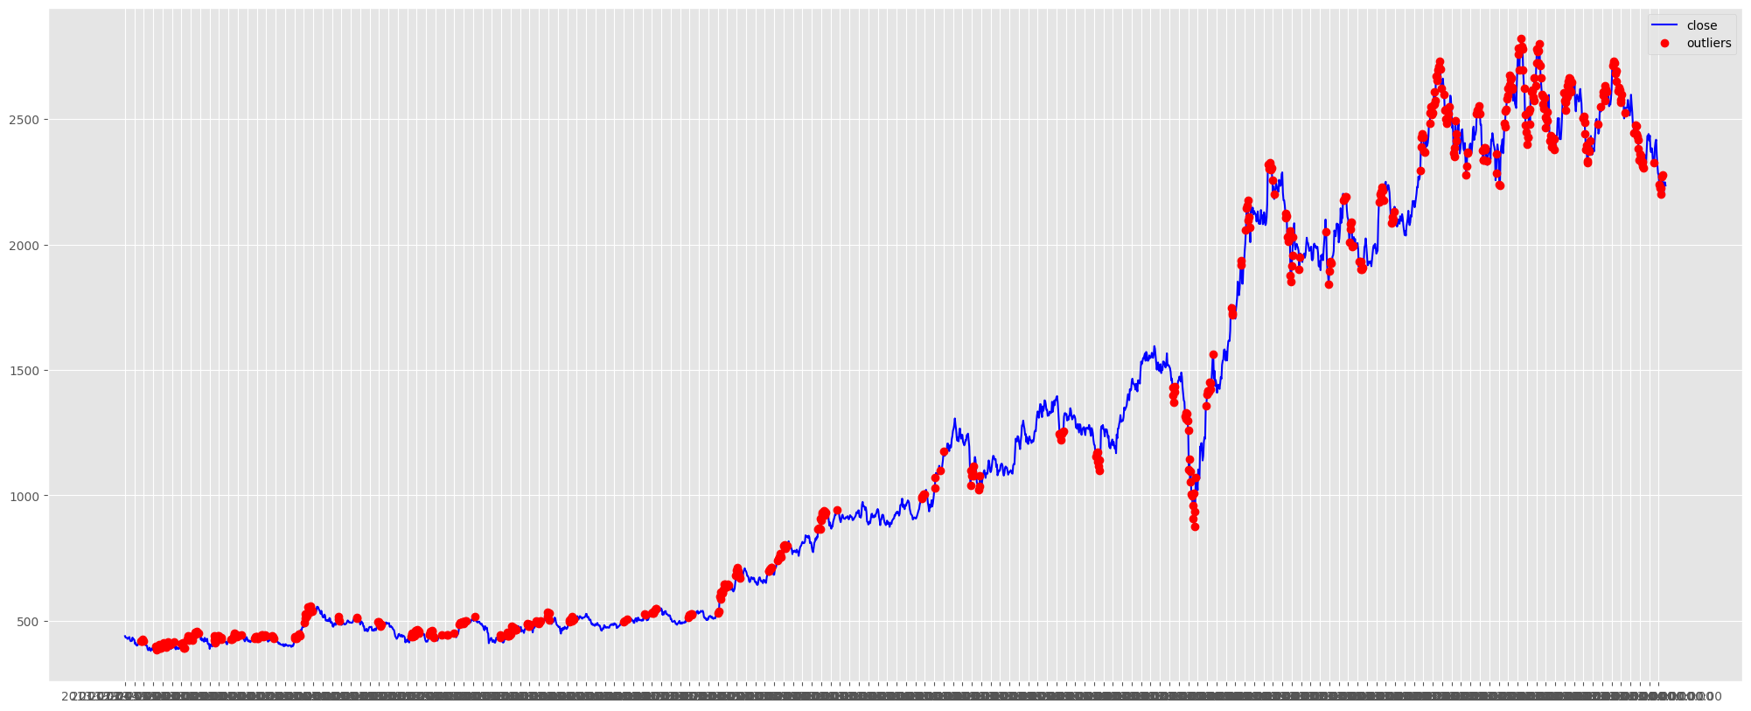
Anomalies in the data

Slide 15
Fitting a regression line
Notes:
As we know, all these parameters follow the same pattern without much deviation
Theres a dip in between 2020-2021. It signifies a sudden dip in the market for Reliance.

Slide 16
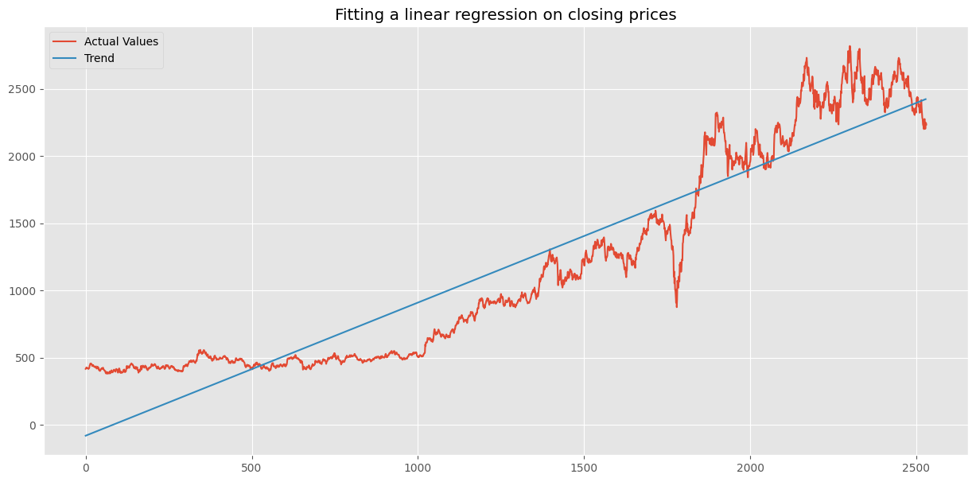
reg.coef_ = 0.99073177

Slide 17
Time series decomposition
There are the components of a time series
Trend
Seasonality
Cycle
Noise
These components can be visualized using decomposition techniques, such as seasonal decomposition of time series (STL) or seasonal decomposition using moving averages (SMA).
Notes:
I will proceed with seeing how a time series is decomposed.These are the components of a time series
Trend: The trend component represents the long-term changes in the time series data. It can be upward, downward, or flat.
Seasonality: The seasonality component represents the repeating patterns or cycles in the time series data that occur at fixed intervals, such as daily, weekly, or yearly.
Cycle: The cycle component represents the longer-term, non-repeating patterns in the time series data that occur over several years or more.
Irregularity or noise: The irregularity component represents the random fluctuations or noise in the time series data that cannot be explained by the other components
These components can be visualized using decomposition techniques, such as seasonal decomposition of time series (STL) or seasonal decomposition using moving averages (SMA).STL decomposes a time series into trend, seasonal, and irregular components using a non-parametric approach, while SMA decomposes a time series into trend, seasonal, and irregular components using a moving average approach.

Slide 18
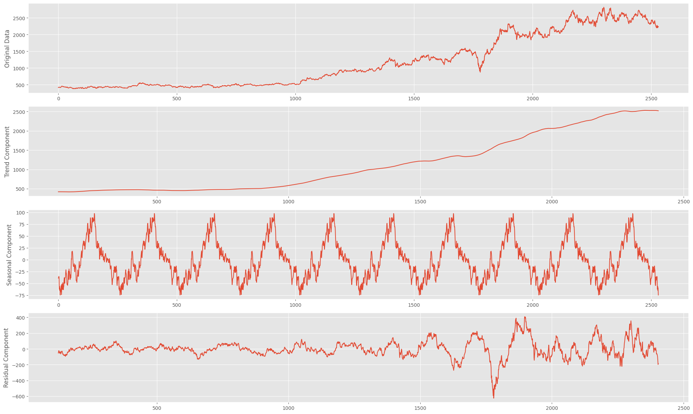
Decomposition of the closing prices of the data set:
Notes:
This plotted graph depicts the decomposition of the closing prices as given in the dataset.
The trend,seasonal and the residuals are shown in the figures.

Slide 19
Augmented Dickey Fuller Test
Null Hypothesis (H0): If failed to be rejected, it suggests the time series has a unit root, meaning it is non-stationary. It has some time dependent structure.
Alternate Hypothesis (H1): The null hypothesis is rejected; it suggests the time series does not have a unit root, meaning it is stationary. It does not have time-dependent structure.
Interpretation of p-value :
p-value > 0.05: Fail to reject the null hypothesis (H0), the data has a unit root and is non-stationary.
p-value <= 0.05: Reject the null hypothesis (H0), the data does not have a unit root and is stationary.
Results of Dickey Fuller test
Test Statistics -7.098251
p-value 4.233675e-10
Notes:
Augmented Dickey Fuller Test
The Augmented Dickey-Fuller test is a type of statistical test called a unit root test.The intuition behind a unit root test is that it determines how strongly a time series is defined by a trend. There are a number of unit root tests and the Augmented Dickey-Fuller may be one of the more widely used. The null hypothesis of the test is that the time series can be represented by a unit root, that it is not stationary (has some time-dependent structure). The alternate hypothesis (rejecting the null hypothesis) is that the time series is stationary.
We interpret this result using the p-value from the test. A p-value below a threshold (such as 5% or 1%) suggests we reject the null hypothesis (stationary), otherwise a p-value above the threshold suggests we fail to reject the null hypothesis (non-stationary).After performing the dickey fuller test, this is the results we got. Given the p value > 0.05 we can conclude that the dataset is not stationary.

Slide 20
LSTM
Long Short-Term Memory (LSTM) networks are a type of recurrent neural network (RNN) designed to overcome the limitations of traditional RNNs, such as the vanishing and exploding gradient problems. They are particularly effective in learning long-range dependencies in sequence data.
LSTM networks consist of specialized memory cells that enable them to remember and process information over longer time steps. These cells contain three key components, called gates:
Input gate: Decides which information from the current input will be stored in the cell state.
Forget gate: Determines which information from the previous cell state will be discarded or retained.
Output gate: Controls which information from the cell state will be passed to the next hidden state.
By using these gates, LSTM networks can selectively store, update, and access information, making them capable of handling complex, long-range dependencies in various applications, such as natural language processing, time-series prediction, and speech recognition.
We will be comparing R^2, MAE and MSE of the model with four different hyperparameter combinations

Slide 21
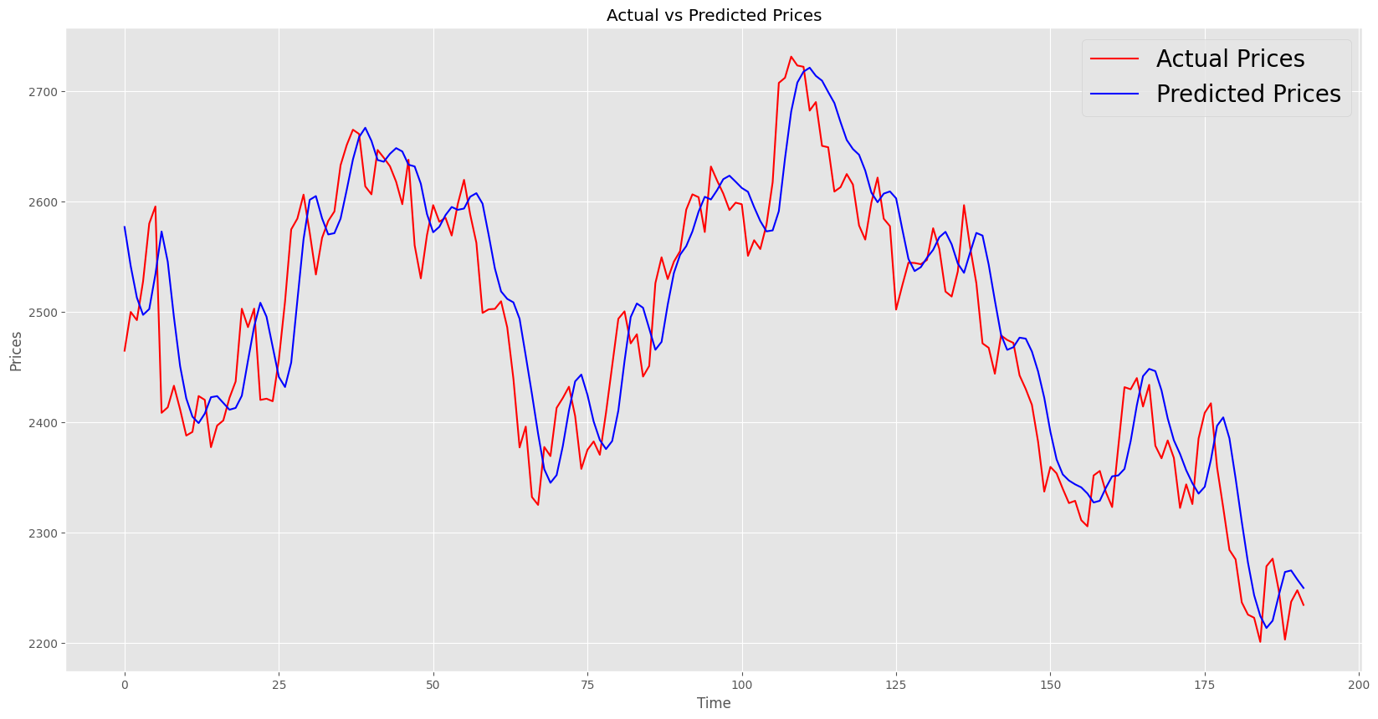
Decomposition of the closing prices of the data set:
Mean absolute error is 40.18437322517904 Mean squared error is 2483.0970630339975 Mean absolute percentage error is 1.628555150998405
Notes:
This plotted graph depicts the decomposition of the closing prices as given in the dataset.
The trend,seasonal and the residuals are shown in the figures.

Slide 22
Conclusion of LSTM

Slide 23
XGBoost
XGBoost (eXtreme Gradient Boosting) is a powerful machine learning algorithm that is used for supervised learning tasks, such as regression and classification. It is an ensemble algorithm that combines multiple weak models (typically decision trees) to create a strong model that can make accurate predictions.
XGBoost works by iteratively adding decision trees to the ensemble model and updating the model in a way that reduces the error of the predictions. At each iteration, the algorithm calculates the gradient of the loss function with respect to the current model predictions, and then fits a decision tree to the negative gradient of the loss function. This tree is then added to the ensemble and the algorithm repeats the process until the specified number of trees is reached or the error is minimized.

Slide 24
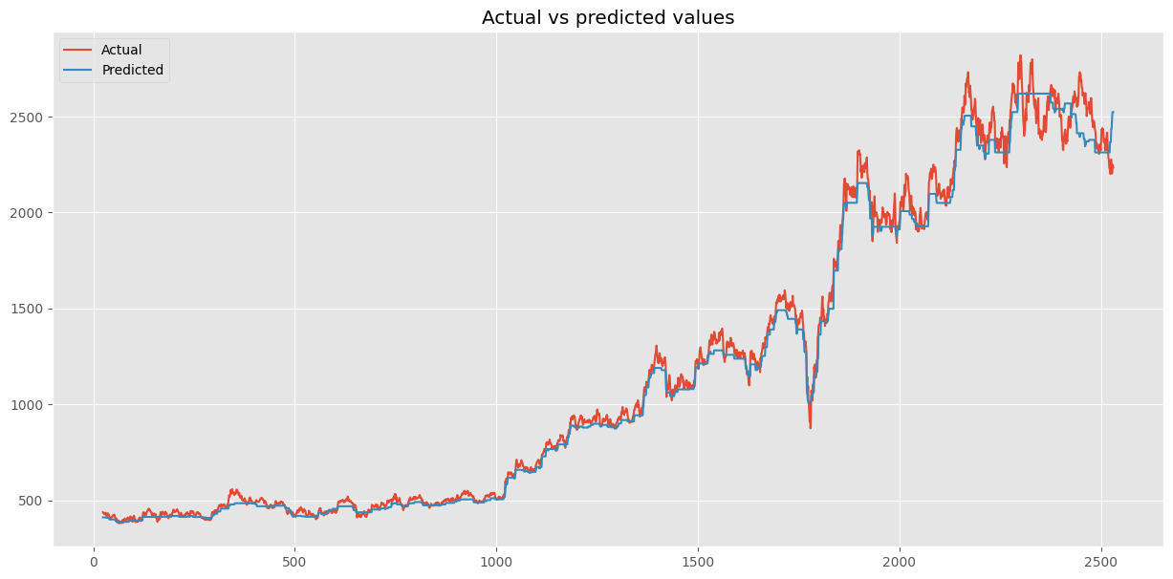
Mean absolute error is 41.79696103225892 Mean squared error is 3818.214703340488
Mean absolute percentage error is 3.4243100426592386
Notes:
This plotted graph depicts the decomposition of the closing prices as given in the dataset.
The trend,seasonal and the residuals are shown in the figures.

Slide 25
Conclusion of XGBoost

Slide 26
Comparison

